Slide 1
GRAM POSITIVE COCCI staphylococci
Dr.R.S.Gopika
Professor & HOD
Dept. of Pathology
skhmc

Slide 2
Staphylococcus
Staphylo- bunch
Kokkos – berry
first identified in (1871) by Von Recklinghausen in pus from a surgical abscess in a knee joint
Named by Sir Alexander Ogston(1880)
Common inhabitant of the skin and mucous membranes

Slide 3
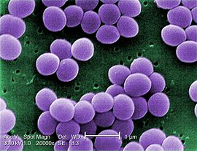
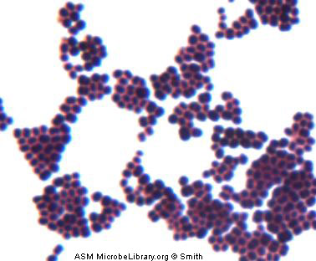
Staphylococcus aureus
.7 -1.2µm.
Non flagellate
Non motile
Non spore forming

Slide 4
Cultural characters
Temp – 10-42ºC
OT - 37ºC
Aerobes
NA- 2-4mm, circular, smooth, convex, opaque
22ºC- pigment-golden yellow
Mac Conkeys agar- small pink,
BA- ß haemolysis
Manitol salt media – colonies surrounded by yellow zone.

Slide 5
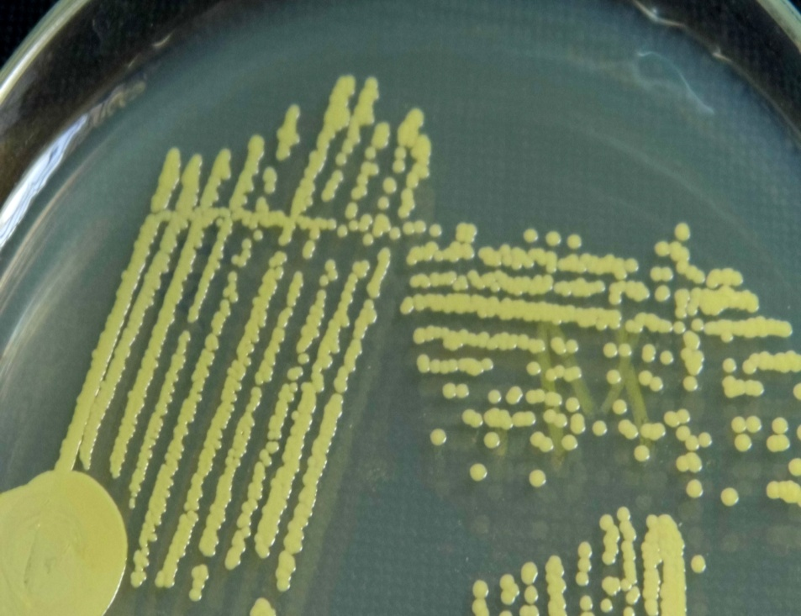
S. aureus growing on a nutrient agar plate
2-4mm, circular, smooth, convex, opaque
yellow pigment

Slide 6
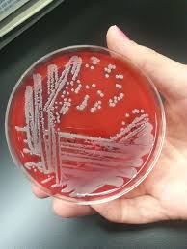
Blood agar - ß haemolysis

Slide 7
Mac Conkeys agar- small pink

Slide 8
Biochemical reactions
Coagulase positive
Catalase positive
Ferment sugar- acid, no gas
Hydrolyse urea
Liquefy gelatin
Reduce nitrates to nitrites

Slide 9
Tube Coagulase Test
0.1 ml broth culture + 0 .5ml plasma
tube incubated at 37º C - 3-6 hrs- clot

Slide 10
Catalase test
The presence of catalase in a tissue sample can be tested by adding hydrogen peroxide and observing the reaction.
Columbia agar with sheep blood, 24 hours, aerobic atmosphere, 37°C. The formation of bubbles, oxygen, indicates a positive result.

Slide 11
Catalase test

Slide 12
Dnase TEST
In DNase agar without indicator
the hydrolysis of DNA is observed by a clearing of the agar after addition of HCL
The acid precipitates unhydrolyzed DNA making the medium opaque.
DNase producing colonies hydrolyze DNA and produce a clear zone around the growth.

Slide 13
Resistance
TDP- 62ºC- 30 min
60ºC- 30 min
1% phenol- 15 min

Slide 14
Staphylococcus
Site of colonization –
Anterior nares
Axilla
Perineum
Most common route of infection – skin
MC source of infection –pts own colonizing strain

Slide 15
Pathogenicity & virulence
Cell associated factors
Cell surface proteins
Extra cellular enzymes
Toxins

Slide 16
Cell associated factors
Cell wall peptidiglycans-
activation of C- release of cytokines
Teichoic acid –
Ag enic, adhesion,prevent opsonosation
Capsular polysaccharides- microcapsule, inhibit phagocytosis.

Slide 17
Cell surface proteins
Protein A-
reacts with Fc region of Ig G, chemotactic,prevent opsonization,unduction of platelet damage
Clumping factor –
binds to fibrinogen
Fibrinonectin binding protein- –
binds to fibrinonectin

Slide 18
Extra cellular enzymes
Coagulase
Lipases
Staphylokinase(fibrinolysin) spreading
Hyaluronidase infection
Nuclease

Slide 19
Enzymes:
Coagulase – coagulates plasma and blood; diagnostic
Hyaluronidase – digests connective tissue
Staphylokinase – digests blood clots
DNase – digests DNA
Lipases – digest oils; enhances colonization on skin
Penicillinase – inactivates penicillin

Slide 20
Toxins
Haemolysin
Alpha haemolysins-
lysis RBC, WBC, cytotoxic, neurotoxic,toxic to muscles ,renal cortex.
ß haemolysins- lyse RBC
Gamma haemolysins
Leucocidine - lyse WBC

Slide 21
Toxins….
Surface Ag’s
- TSST- toxin shock syndrome toxin
stimulate T lym IL1,IL2,TNF,IF multisystem involvement,
- Enterotoxin-
pyogenic, mitogenic, hypotensive, thrombocytopenic and cytotoxic effect, resist 100ºC for 10- 40 min

Slide 22
Toxins …..
Exfoliative toxin/ epidermolytic toxin
-seperation of epidermis from dermis
SSSS
Severe form – Ritters syndrome in newborn
Milder forms – pemphigus neonatorum
- bullous impetigo

Slide 23
Pathogenesis
Colonization
Introduction into tissues
Invasion
Evasion of host defense mechanisms
Metastatic spread

Slide 24
Clinical spectrum of Staph infection
Toxin mediated diseases
Non Toxin mediated diseases
Nosocomical infection
Community based infection
Pyogenic
Non pyogenic

Slide 25
S. Aureus –pyogenic lesions
a range of illnesses,
minor skin infections- pimples, impetigo, boils (furuncles), cellulitis folliculitis, carbuncles, scalded skin syndrome, and abscesses,
life-threatening diseases - pneumonia, meningitis, osteomyelitis, endocarditis, toxic shock syndrome (TSS), bacteremia, and sepsis.
incidence ranges from skin, soft tissue, respiratory, bone, joint, endovascular to wound infections

Slide 26
Staphylococcal skin infections include:
Impetigo (school sores)
Ecthyma (crusted ulcers)
Cellulitis (more often due to streptococcus)
Hair follicle infections -staphylococcal folliculitis , boils ,furuncles & carbuncles and sycosis (beard infection)
Secondary skin infection - of wounds, dermatitis, scabies, diabetic ulcers etc.
Staphylococcal hypersensitivity reactions such as folliculitis decalvans

Slide 27
Impetigo

Slide 28
Hair follicle infections

Slide 29
Skin disease due to toxins produced by the bacteria include:
Staphylococcal scalded skin syndrome (SSSS)
usually affects
- children less than five years old
- rarely, adults with kidney failure.

Slide 30
SSSS
Severe form – Ritters syndrome in newborn
Milder forms – pemphigus neonatorum
- bullous impetigo
c/f –
local tender blisters & bullae exfoliation
& separation of outer epidermal layer.
Ritters syndrome- + fever, lethargy, irritability ,poor feeding

Slide 31
Toxic shock syndrome
relatively uncommon illness resulting from the release of Toxic Shock Syndrome Toxin-1 (TSST-1) or enterotoxin B.
These toxins are also known as superantigens (capable of generating a massive inflammatory response).
Previous exposure makes a patient immune to these toxins i.e. they will not have a second attack.

Slide 32
Toxic shock syndrome .
Multisystem disease with
fever,
hypotension,
myalgia,
Vomiting, Diarrhoea,
mucosal hyperemia,
erythematous sun burn,
rash,
Later –liver.kidney,GIT & CNS is affected - Disoreintation

Slide 33
Musculoskeletal-
OM , arthritis, bursitis, pyomyositis,abscess
Respiratory –
tonsilitis, phrangitis, sinusitis, otitis, BP, lung abscess, empyema
CNS-
abscess, meningitis
Endovascular –
bacteremia, septicemia, pyemia, endocarditis
Excretory system –
UTI

Slide 34
Staphylococcal Food Poisoning (Staphylococcal intoxication)
Ingesting preformed enterotoxin by Staph. Aureus
High resistance to heat
Resistant to drying out
Resistant to high osmotic pressures
Resistant to high salt conc.
Found in nasal passages and hands
Contaminate food

Slide 35
Food items
Milk products
Bakery food
Processed meat
Salads
Incubation period – 1-6 hrs

Slide 36
Toxin
Stimulates vagus nerve
Triggers vomiting reflex center of brain
Stimulates intestinal peristaltic movement
N,V, Abdominal cramps & diarrhea.
Recovery usually complete in 24 hours.
Mortality rate – 0 % in healthy people

Slide 37
Most reliable method of preventing Staphylococcal intoxication:
Adequate refrigeration during storage to prevent toxin production

Slide 38
LAB
Pus
Blood
Urine
CSF
Gram staining, culture ,biochemical test
PCR,DNA finger printing

Slide 39
S. epidermidis
Initial adhesion to prosthetic device - intravasal catheters, metal plates and screws in osteosynthesis, cardiac pacemakers, artificial heart valves
Colonization
proliferate on the surface and produce a polymeric substance
enter the bloodstream and cause
sepsis like illnesses.

Slide 40
S. saprophyticus
responsible for 10–20% of acute urinary tract infections,
particularly in young women

Slide 41
https://commons.wikimedia.org
https://www.edu.gov
Text Book of Microbiology-Anandanarayanan

